Slide 1
Chapter 13
CORRELATION

Slide 2
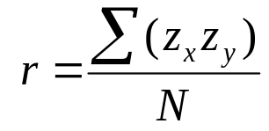
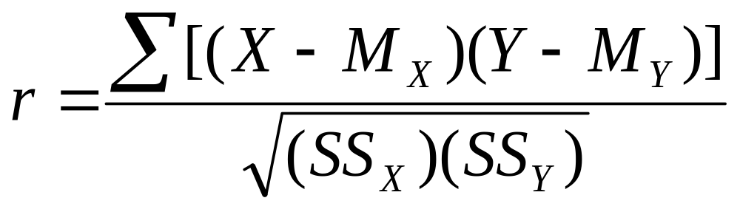
Pearson r

Slide 3
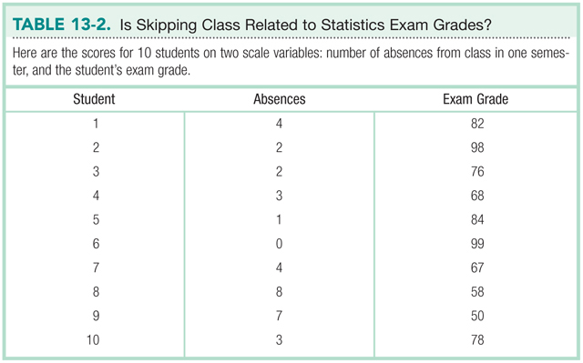
Calculating r

Slide 4
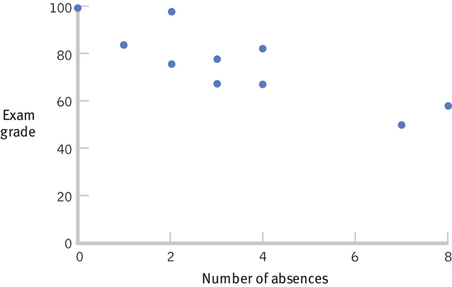
Scatterplot

Slide 5
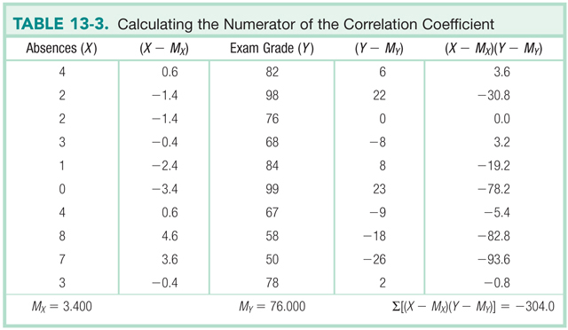
Calculating r: Numerator

Slide 6
Calculating r: Numerator

Slide 7
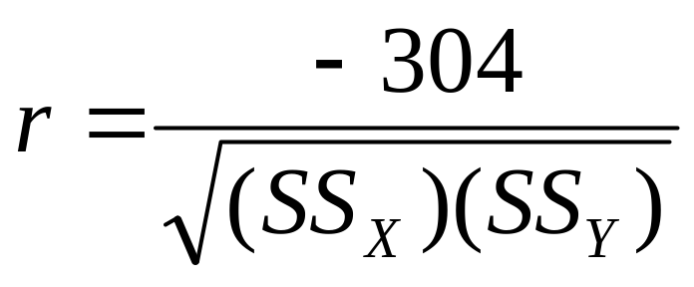
Calculating r

Slide 8
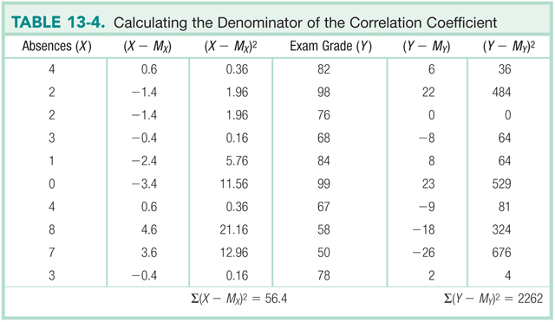
Calculating r: Denominator

Slide 9
Calculating r: Denominator

Slide 10
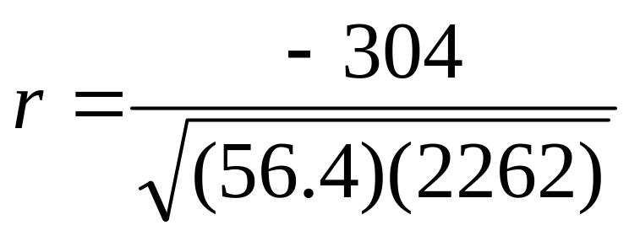
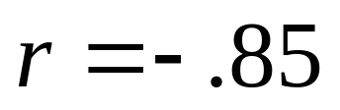
Calculating r

Slide 11
Hypothesis Testing with r
r can be used as a descriptive statistic
Can also be used as an inferential statistic
  Test whether correlation is significantly different from no correlation (r = 0)

Slide 12
Assumptions
Subjects are randomly selected
Underlying population distributions for X and Y are approximately normal
Each variable should vary equally

Slide 13
Step 1: Identify
Population
  Students like those studied
  Students for whom there is no correlation between number of absences and exam grade
Comparison distribution
  Distribution of all possible correlations between X and Y with a sample size of 10
Assumptions
  Subjects not randomly selected
  Unknown population distributions
  Variability in X and Y is roughly the same

Slide 14
Step 2: H₀ & H₁
Null Hypothesis
  There is no correlation between number of absences and exam grade
  H₀: r = 0
Research Hypothesis
  There is a correlation between number of absences and exam grade
  H₁: r ≠ 0

Slide 15
Step 3: Identify the Sampling Distribution
df_{r} = N – 2
df_{r} = 10 – 2 = 8

Slide 16
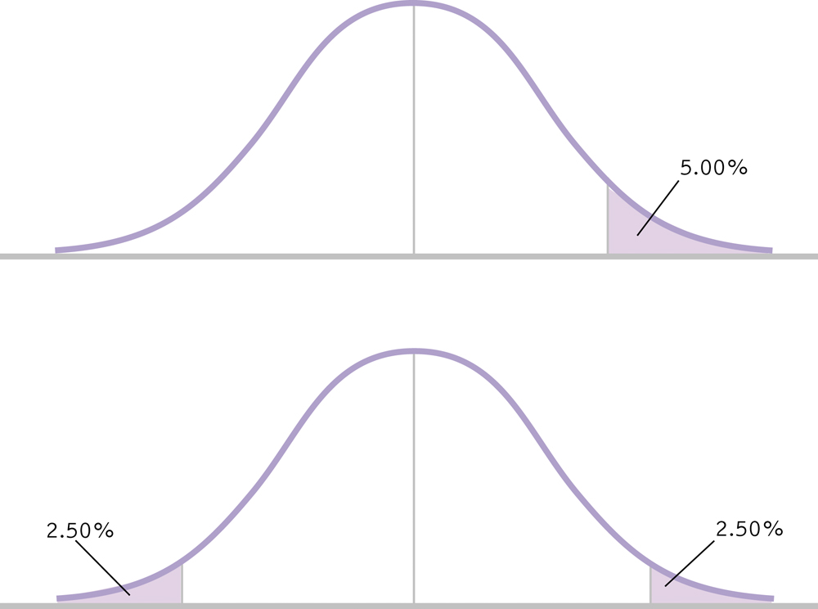
Step 4: Determine Critical Values
critical r = .632
-.632
.632

Slide 17
Step 5: Calculate r
r = -.85

Slide 18
Step 6: Make a Decision
Is the calculated r in the rejection region?
-.85
-.632
.632

Slide 19
Step 6: Make a Decision
Reject H₀
There is a significant, negative correlation between number of absences and exam, r(8)=-.85, p < .05.

Slide 20
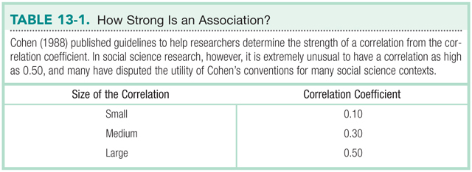
Effect size?
r value serves as effect size

Slide 21
Factors that Influence r
Non-linear relationships
Truncated range
Outliers

Slide 22
Correlation ≠ Causation
There is a .91 correlation between ice cream consumption and drowning deaths
Does eating ice cream cause drowning?
Does grief cause us to eat more ice cream?
Likely a third variable (i.e., time of year)

Slide 23
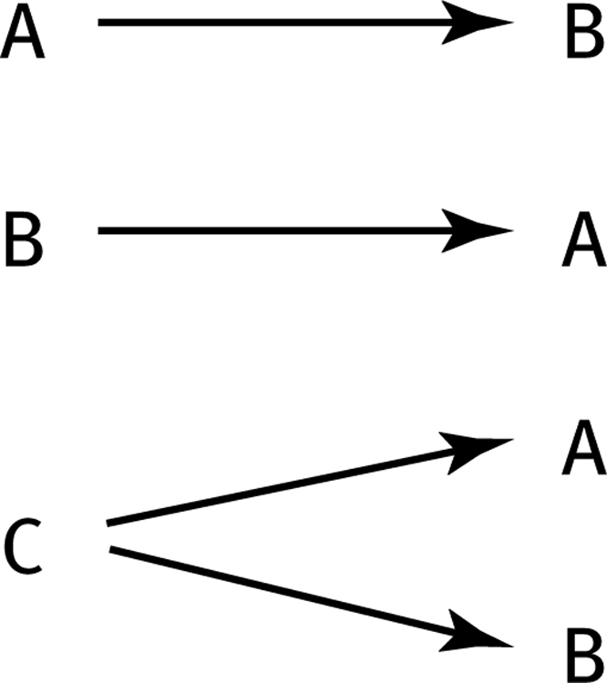
Correlation ≠ Causation
Three Possible Causal Explanations for a Correlation

